Slide 1
Problem Statements and Requirements
Zhenbin Li
IETF 105, Montreal, Canada

Slide 2
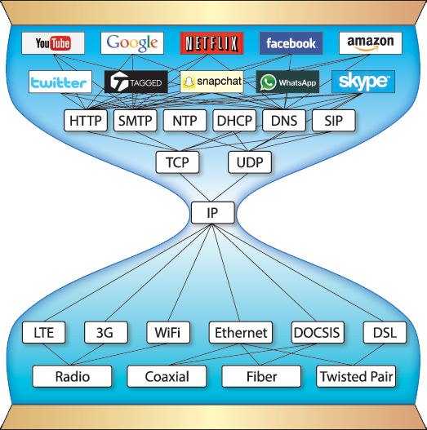
Problem Statements (1)
Bottleneck for Transport Networks of Operators: Pipe only
BW requirement increasing greatly
Less revenue from the beared service

Slide 3
Problem Statements (2)
Bottleneck for Transport Networks of Operators: Networking on its own
VPN
MPLS L3VPN
6PE/V6PE
MPLS VPWS
MPLS VPLS
MPLS EVPN
EVPN + SR-MPLS
L3VPN + SR-MPLS
SRv6 L3VPN
SRv6 EVPN
TE
RSVP-TE
MPLS CR-LDP
MPLS-TP
Stateful PCE
SR-TE
SRv6 TE
FRR
TE FRR (Bypass)
TE FRR (Detour)
IP/LDP FRR
LFA
R-LFA
TI-LFA (SR-MPLS)
TI-LFA (SRv6)

Slide 4
Problem Statements (3)
Challenges of value-added services based on the existing application-aware methods
5 Tuples using for ACL/PBR
Indirect application info which is in need of transition
Forwarding performance issues
Scalability issues come from the limitation of hardware resource
DPI (Deep Packet Inspection)
Challenges from network neutrality
Challenges from network security
Forwarding performance issues

Slide 5
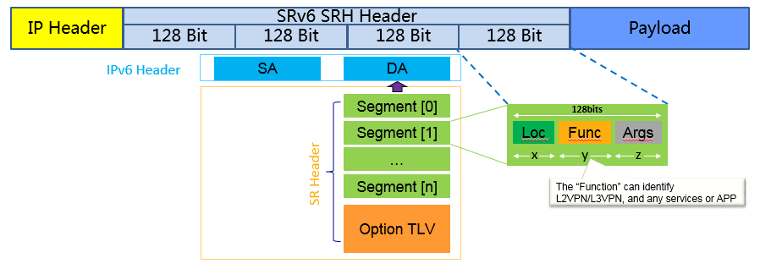
Emerging Work in IETF
New services distributed in WGs
Network Slicing
DetNet
OAM
IOAM
SFC
SD-WAN
BIER
…
Open box by SRv6 for IPv6 to encap information for different services.

Slide 6
Requirements
Convey the explicit app-aware information to the transport network based on IPv6 data plane.
Combine the app-aware information with the new services based on IPv6 data plane:
Finer granularity services.
Better forwarding performance
More Scalability
Open options for user choice instead of forced DPI
Network measurement for better SLA compliance based on IPv6 data plane:
Fine granularity ( per packet vs. per flow, per node vs. E2E, individual vs. statistics, etc. )
Integrated ( per packet with per flow, per node with E2E, individual with statistics, in-band with out-band, passive with active, etc. )

